Slide 1
Chapter 6 Graphs

Slide 2
99 台大工科
(1) use a C-like language to declare the data structure of “adjacency list” which combines array and pointer structures. (10%)
(2) show the “adjacency list” representation of the following graph (10%)
(3) write a recursive DFS procedure that bases on the “adjacency list” representation to traverse a graph (10%)
(4) show the biconnected components of the following graph (10%)

Slide 3
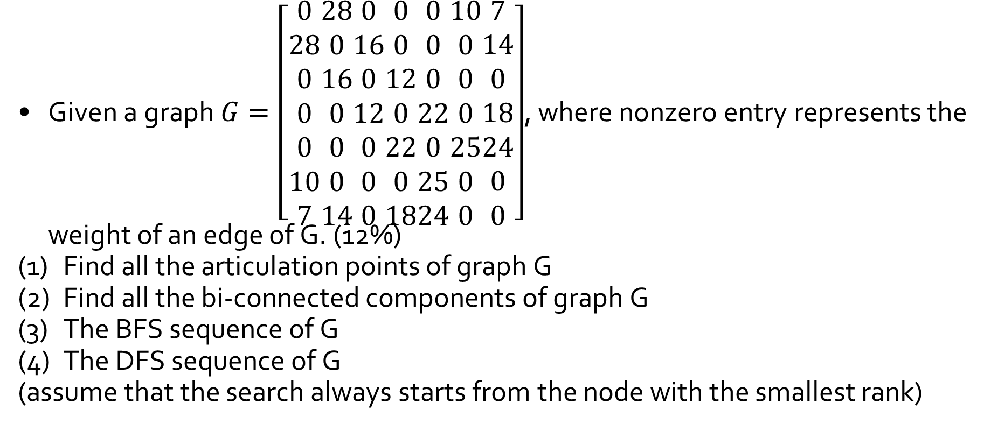
97 清大資工
Given a graph $G=\left[\begin{aligned}0 \\ 28 \\ 0 \\ 0 \\ 0 \\ 10 \\ 7\end{aligned}\begin{aligned}28 \\ 0 \\ 16 \\ 0 \\ 0 \\ 0 \\ 14\end{aligned}\begin{aligned}0 \\ 16 \\ 0 \\ 12 \\ 0 \\ 0 \\ 0\end{aligned}\begin{aligned}0 \\ 0 \\ 12 \\ 0 \\ 22 \\ 0 \\ 18\end{aligned}\begin{aligned}0 \\ 0 \\ 0 \\ 22 \\ 0 \\ 25 \\ 24\end{aligned}\begin{aligned}10 \\ 0 \\ 0 \\ 0 \\ 25 \\ 0 \\ 0\end{aligned}\begin{aligned}7 \\ 14 \\ 0 \\ 18 \\ 24 \\ 0 \\ 0\end{aligned}\right]$, where nonzero entry represents the weight of an edge of G. (12%)
Find all the articulation points of graph G
Find all the bi-connected components of graph G
The BFS sequence of G
The DFS sequence of G
(assume that the search always starts from the node with the smallest rank)

Slide 4
95 交大工工
Consider the following undirected graph
(1) Write the depth first spanning tree starting at node 0 (visit the smaller number first) (3%)
(2) Write the breadth first spanning tree starting at node 0 (visit the smaller number first) (3%)
0
4
1
2
7
6
5
3

Slide 5
98 中央資管
Given the graph as shown in follows
Obtain the adjacency list representation for the graph, staring at vertex A.(10%)
Obtain the depth first spanning tree. Explain your answer. (10%)
A
E
B
F
H
C
D
G

Slide 6
97 中山資工
Consider the following weighted graph
Show the order in which the edges are added to the minimum cost spanning tree using Prim’s algorithm.
Show the order in which the edges are added to the minimum cost spanning tree using Kruskal’s algorithm.
36
16
A
B
C
14
10
G
12
18
24
F
25
E
D
22

Slide 7
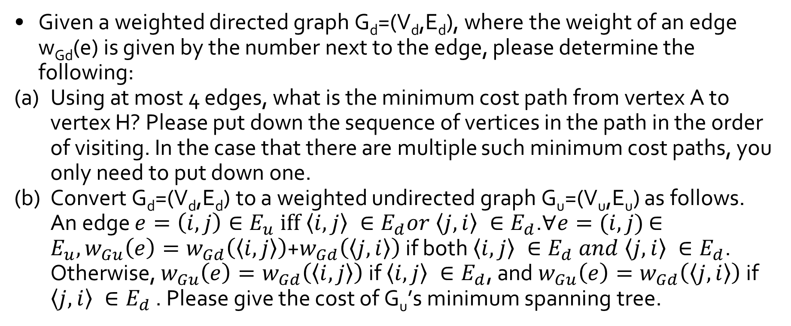
105 台大資工
Given a weighted directed graph G_{d}=(V_{d},E_{d}), where the weight of an edge w_{Gd}(e) is given by the number next to the edge, please determine the following:
Using at most 4 edges, what is the minimum cost path from vertex A to vertex H? Please put down the sequence of vertices in the path in the order of visiting. In the case that there are multiple such minimum cost paths, you only need to put down one.
Convert G_{d}=(V_{d},E_{d}) to a weighted undirected graph G_{u}=(V_{u},E_{u}) as follows. An edge $e=\left(i,j\right)∈E_{u} iff \left\langle i,j\right\rangle ∈E_{d}or \left\langle j,i\right\rangle ∈E_{d}$.$∀e=(i,j)$ $∈E_{u}, w_{Gu}\left(e\right)=w_{Gd}\left(\left\langle i,j\right\rangle \right)$+$w_{Gd}\left(\left\langle j,i\right\rangle \right)$ if both $\left\langle i,j\right\rangle ∈E_{d} and \left\langle j,i\right\rangle ∈E_{d}$. Otherwise, $w_{Gu}\left(e\right)=w_{Gd}\left(\left\langle i,j\right\rangle \right)$ if $\left\langle i,j\right\rangle ∈E_{d}$, and $w_{Gu}\left(e\right)=w_{Gd}\left(\left\langle j,i\right\rangle \right)$ if $\left\langle j,i\right\rangle ∈E_{d}$ . Please give the cost of G_{u}’s minimum spanning tree.

Slide 8
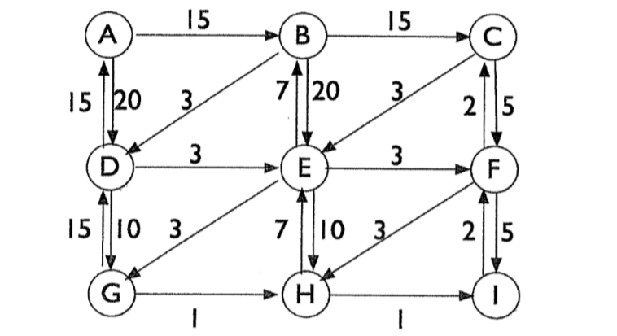
105 台大資工

Slide 9
97 成大電機
The following directed graph is an AOE network which represents a project form its starting o its finishing. Compute the earliest time (ee), latest time(le), and the allowed slack of each activity, Then determine which activities are critical. (15%)
a₄=5
1
4
7
a₁=6
a₁₁=2
a₁₆=4
a₅=3
a₇=4
a₁₄=6
start
0
a₂=8
2
a₁₀=0
6
9
finish
a₆=6
a₈=2
a₁₂=4
a₁₅=5
a₃=4
a₁₇=3
3
a₉=3
5
a₁₃=7
8

Slide 10
Q&A

